Slide 1
Labor and Childbirth
Presented by: Sierra, RN-III
Pardee Hospital Women and Children’s Unit

Slide 2

Arriving at the Hospital
Entrances
Triage
    Residents and on-call physicians
    Latent/early labor
    Discharge instructions
pregnancy.lovetoknow.com
Notes:
Begin at the ER entrance, they will ask for your name, birthday, due date, and doctor that you see for OB care.
You will be brought up to our floor and seen by a resident physician who will see you, perform exam as needed, and then be in contact with your provider for a plan. Often, women come in in what we call “latent/early labor” meaning that you might be experiencing contractions anywhere from 5-20min apart that are irregular or not strong enough to change your cervix. We will treat, evaluate, and sometimes this means you will be sent home with precautions on when to return. Remember the 5-1-1 rule… contractions are in a regular pattern 5min apart or less, consistent/regular for 1 hour, and each contraction lasts about 1min long.

Slide 3

Delivery Preparedness
Resident/physician on call
What to pack
Visiting hours
Waiting room vs. Visitors in room
Labor rooms vs. Birthing suite
safebirthproject.com
Notes:
We do have resident providers.. meaning that depending on which providers you see, you could have residents involved in your care throughout your delivery. Also, every office has on call physicians, so be prepared to possibly meet a provider that you have only met once or twice before. Don’t be nervous! You are still able to voice your birth plan wants/desires and we will do our best to honor all wishes.
You don’t have to pack much to the hospital. We have birthing balls and peanut balls; pillows and blankets; refreshments; tshirts with “mittens” for the babies; gowns for you; panties and pads for postpartum; and we supply diapers and wipes for the babies. (And more!) However, you are welcome to pack these things as well if you have preferences.
**During this COVID-19 concerns, YOU MAY ONLY HAVE ONE SUPPORT PERSON PRESENT THROUGHOUT DURATION OF YOUR STAY. No children are allowed. This person needs to limit the amount of times they leave your room to minimize exposure. The waiting room will not be in use for extra visitors. Again, only one visitor will be permitted.
We do have a birthing suite for unmedicated/natural births. There is admission criteria for this room, so if you are interested, please speak to your doctor.

Slide 4
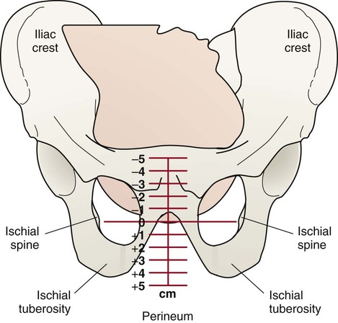
Labor
Spontaneous vs. Induction
Dilation, effacement, station
How to time contractions
Labor signs
nursekey.com
Notes:
Some deliveries require an induction process whether it be a medically induced decision (i.e. high blood pressure, gestational diabetes, suspected large baby via ultrasound, low fluid level, etc.) or if you have gone past your due date and the doctor recommends an induction. There are a few different medications/devices used to help with induction including foley ball insertion to manually help dilate your cervix or medications like cytotec, cervadil, or Pitocin. If you are being induced, your doctor will discuss these with you and recommend your best options. (Sometimes this includes a combination of these mentioned!)
You will dilate from 1-10cm throughout your labor progression. Active labor is typically around 6cm-10cm. You will start pushing at 10cm. Often, women will be 1-4cm dilated over a course of multiple weeks! Don’t be alarmed! It is a good thing to be slowly dilating prior to real labor. Many women will continue working jobs/performing normal everyday activities during this time with minimal pains/complaints.
Contractions are timed from the start of one contraction to the start of the next. So often, contractions that are 3min apart, lasting approximately 1min, will feel like you have no break in between them. This is all part of the process. ☺
Some signs of labor:
--Bag of waters breaks (may be a gush, may just be a continual leaking, both are normal) If you suspect your water has broken, come to the hospital, even if you are not contracting, if you water has broke we want you to deliver within 24 hours or so to reduce infection (sometimes infection symptoms come on even sooner). You may need some medication to help start your labor in contractions do not start on their own.
--Vaginal spotting/pink tinged discharge/mucous… no need to come to the hospital immediately if you are having pink/brown tinged mucous; this often is your mucous plug, but you can lose your mucous plug 2-3 weeks prior to labor in some cases. Remember some light bleeding/spotting after a vaginal exam is normal. BUT if you are having heavy vaginal bleeding, like a period, you should be evaluated by your doctor either at the office or the hospital.
--Contractions… contractions can be felt in your belly and sometimes in your back also. If you are experiencing contractions, take a walk, drink lots of water, eat a snack, rest on your left side, if the contractions slow down, they are likely Braxton hicks or “latent labor” contractions and you do not need to be evaluated. If they get stronger or pick up in frequency, it could be labor and call/or come in to be seen. Again remember the 5-1-1 rule… contractions are consistently 5min apart, lasting for 1 hour at this regular rate, and are about 1min long.
--Less fetal movement… remember, your baby is running out of room the closer to a term pregnancy you get, so a slight decrease in movement 35 weeks and on is normal. BUT if you notice a drastic change or no movement, try first to drink juice/Gatorade or eat a small sugary snack and lay down on your left side, if the movement is still minimal, then come in to be evaluated. Use your momma gut! ☺
(these are NOT all-inclusive, you may have other signs or symptoms… if you are concerned about any of your symptoms, call your provider or come to the hospital.)

Slide 5
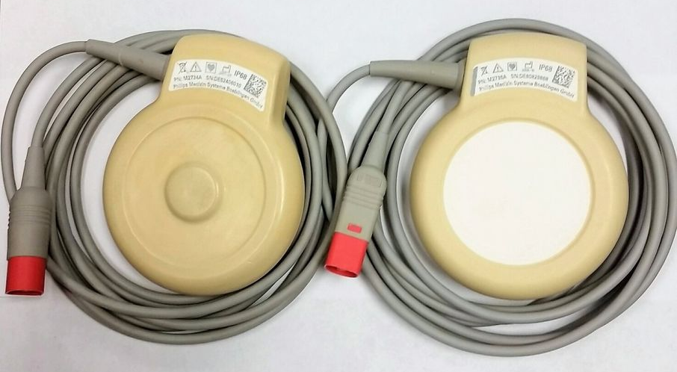
Equipment for Labor
SROM and AROM
    Nitrazine, FERN, amnihook
IV start
External monitoring vs. Internal
Position changes and equipment
    Birthing and peanut balls, birthing bar, rocking chair
Notes:
SROM = spontaneous rupture of membranes… meaning your water broke at home, or in the car, or at your other kids’ dance practice.
AROM = artificial rupture of membranes… meaning your water was broke in the hospital once admitted for labor by your provider with a special instrument (amnihook) that is made especially for this.
Nitrazine and FERN testing is done to confirm your suspicions of your water breaking on it’s own. (Sometimes, you just peed on yourself, and that’s ok! We want to be sure though and these are the tests to do so.)
When admitted for labor, the nurse will start an IV in your arm. This will be access to provide medications to you and/or the baby. Including pain medicine, emergency medication, and even just fluids to help hydrate you and the baby. In most labors, you ARE NOT hooked up to an IV pump throughout your labor, we will just have this access as needed.
External monitoring (see picture above) are monitors that will rest on your belly with belts we provide to monitor baby’s heart rate and your contractions. This is our preferred method of monitoring. If you are low-risk and not being induced, we perform intermittent monitoring to help facilitate your comfort, etc. We do have x1 set of wireless external monitors so that you can walk, etc. freely if you are needing monitored continually.
If you are being induced or have an epidural or we have concerns about the baby, you will be continuously monitored other than for bathroom breaks. This is for your safety as well as the baby’s.
Internal monitors are devices placed through a vaginal exam that will connect to the baby’s head and/or your uterus. These are more invasive and are used sparingly as we are able for this reason.
Position changing is VERY important in labor. Laying on your back the whole time will not effectively help baby descend in the pelvis for a faster delivery. Walking, sitting, laying on your side, rocking in a chair, standing by the bedside, swaying, peanut balls, birthing balls, hands-and-knees positions, etc. are all great positions to try and your labor nurse will help you with any of these and more!

Slide 6
Bathroom Break
Sympathy belly at front of room for brave support people

Slide 7
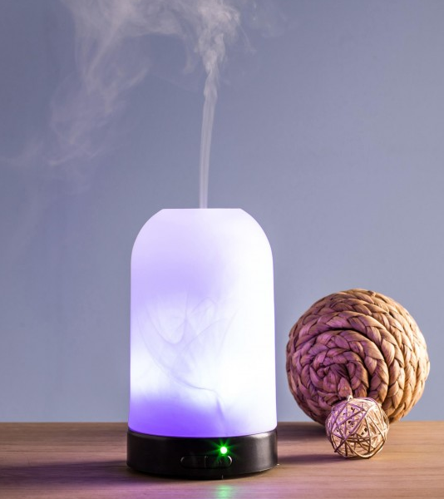
Labor Coping Strategies
Support person
Doulas
    Discuss with physician prior to delivery
Position changing
Walking
Shower/tub
Music, diffusers, and low lighting
kitchenstuffplus.com
Notes:
***DURING THE COVID-19 CONCERNS, YOU WILL ONLY BE ALLOWED X1 SUPPORT PERSON THROUGHOUT THE DURATION OF YOUR STAY. For example, at this time you will not be able to have your partner and a doula. Only one is permitted. We hope you understand our efforts to reduce the spread of disease and protect all our patients, including the other newborns on our floor.
All our labor rooms have a shower that you are able to use for pain control as desired. There is x1 bathtub on our floor that we can potentially use if the room is not already occupied by another patient. We have heating pads that we can supply for pain control. You may also play your own music or bring your own diffuser to the hospital for relaxation. NO CANDLES. Each of our labor rooms have a low-lighting option for your comfort.

Slide 8

Pain Management Options
Position changes
Sterile water injections
IV medication
Epidural
  https://www.youtube.com/watch?v=qXbTEIV3t1o
fitpregnancy.com
Notes:
Again, position changing is so important in labor. Your labor nurse will help facilitate options whether you have an epidural or not.
Sterile water injections are controversial on whether patients have success with them or not. It is four water papules (no medication used) injected with a needle into your lower back. Your nurse can perform this for pain control if you desire.
IV medication is inserted into your IV and usually lasts around 1-2 hours for some relief. Most women still feel all their contractions, but do have good improvement on their pain. The medication used will depend on the doctor’s preference. All medications used are safe for the baby). Some of the ones our providers use include: stadol, fentanyl, and morphine/Phenergan shots).
Epidurals are performed by our anesthesiologists or CRNAs. We use ropivocaine as the medication and sometimes they will dose with fentanyl for added relief if you are needing this. Our epidurals are continuously flowing medication so they do not commonly “wear off.” Your OB doctor may have restrictions on when you can have an epidural. Most doctor’s like to see regular contractions with some sort of cervical change in order to receive an epidural. Please watch the video provided for the process of it’s placement. (If you are squeam-ish, be mindful that there is a needle in this video and some blood, although very little.)

Slide 9
Cesarean Delivery
Scheduled vs. Unscheduled
Attendees
Healthy Mom
and
Healthy Baby
Notes:
You may have one support person come to the operating room with you for delivery. They will sit at your head and will not see the surgery being performed. In most cases you will remain awake and will be able to talk and see and hold the baby.
“HEALTHY MOM AND HEALTHY BABY” – our goal ALWAYS. Sometimes this does involve an unplanned cesarean delivery. This will be discussed with you by your doctor prior to delivery. Reasons may include: stalled dilation, maternal exhaustion after pushing for multiple hours, or an unhappy baby via fetal monitoring, or another reason.
You may have a scheduled cesarean delivery for a breech presentation (meaning baby is not head down), or for a suspected very large fetus, or for a repeat cesarean delivery because you have already had one in the past, or possibly another reason discussed with you by your physician. If this is the case, you will be scheduled for a day on your 39th week to come in and be prepped for surgery. You will come to the Labor and Delivery floor still and we will prep you and take you down to the OR and you will return back on our floor.
We try to perform “family centered” c-sections, meaning that you, your partner, and the baby will all come back up to the floor together once the surgery is complete (usually takes 30min to an hour altogether). There are some factors that complicate this from time to time in which mother will need to recover in PACU while the nurse, the baby, and your partner come back to the floor together to your room until you can join us (usually only 30min or so).

Slide 10
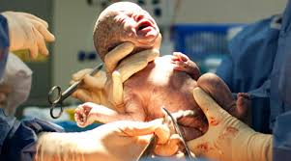
Post-delivery
What not to pack
Medications
Infant rooming-in
Discharge
Varicella and Rubella vaccines
Rhogam
thebump.com
Notes:
What not to pack… We supply diapers, wipes, tshirts with mittens, hats, swaddle blankets, burp rags, shampoo, medications, Similac brand formula and bottles, pacifiers, and a safe place to sleep for the baby. And for mom, we supply gowns, birthing balls, peanut balls, pads, panties, washcloths, towels, pillows, sheets, toothbrush, toothpaste, nipple cream, medications, blankets, and tissues.
Some things to consider bringing if you would like:
For baby-- going home outfit, socks, boppy pillow (if desired) for feedings.
For mother– going home outfit, own personal clothes/gown if you would prefer, your favorite drinks/snacks if desired, shampoo and conditioner (hospital’s is not the best), shoes to walk in room/halls/shower with.
Pertinent item to bring:
--Infant’s car seat – we will discharge baby home with you in his/her car seat with straps, etc. adjusted appropriately. We will help with this if needed. However, we are NOT allowed to help you install the base or the car seat itself in the vehicle. This needs to already be done. You can visit your local fire department who will assist you with this for free. Some departments do recommend calling for an appointment, or they have walk-in hours, so check with the one you plan to use. (You help them out if you have already installed the carseat or base to the best of your knowledge and they “check” it off to be sure done correctly. Try not to show up with your carseat still in the box. ☺)
Try not to bring medications with you to the hospital. And if you do, please let your nurse know. You should not be taking any medications that we do not provide for you.
Infants room-in with their mothers. You will have the same nurse for mom and baby. **There may be changes to this with positive COVID-19 cases.** Please discuss concerns with your provider.
Discharge from the hospital usually occurs within 24-48 hours post-delivery. For uncomplicated vaginal deliveries, closer to 24 hours. For complications or c-section deliveries, expect 48 hours or more.
Varicella – TDAP vaccine usually given later in your pregnancy at a prenatal appointment. It is recommended that you receive this vaccine in each pregnancy to help immunity for infant. Rubella – you will be tested for immunity early in your pregnancy. If you are not immune, you will be given this vaccine postpartum to protect your newborn. If you plan on having someone else watch your infant, their immunity should be tested on both of these as well.
Rhogam – Only a concern for Rh negative mothers. (So, a blood type like A-, B-, O-, or AB-) a medication (a shot) given at around 28 weeks pregnant and then again post-delivery if your newborn’s blood type is positive. If you are Rh negative, we will test the blood from the cord (totally painless for you and baby) to determine infant’s blood type. Don’t worry, sounds kind of confusing, but your doctor will explain if this applies to you. ☺

Slide 11
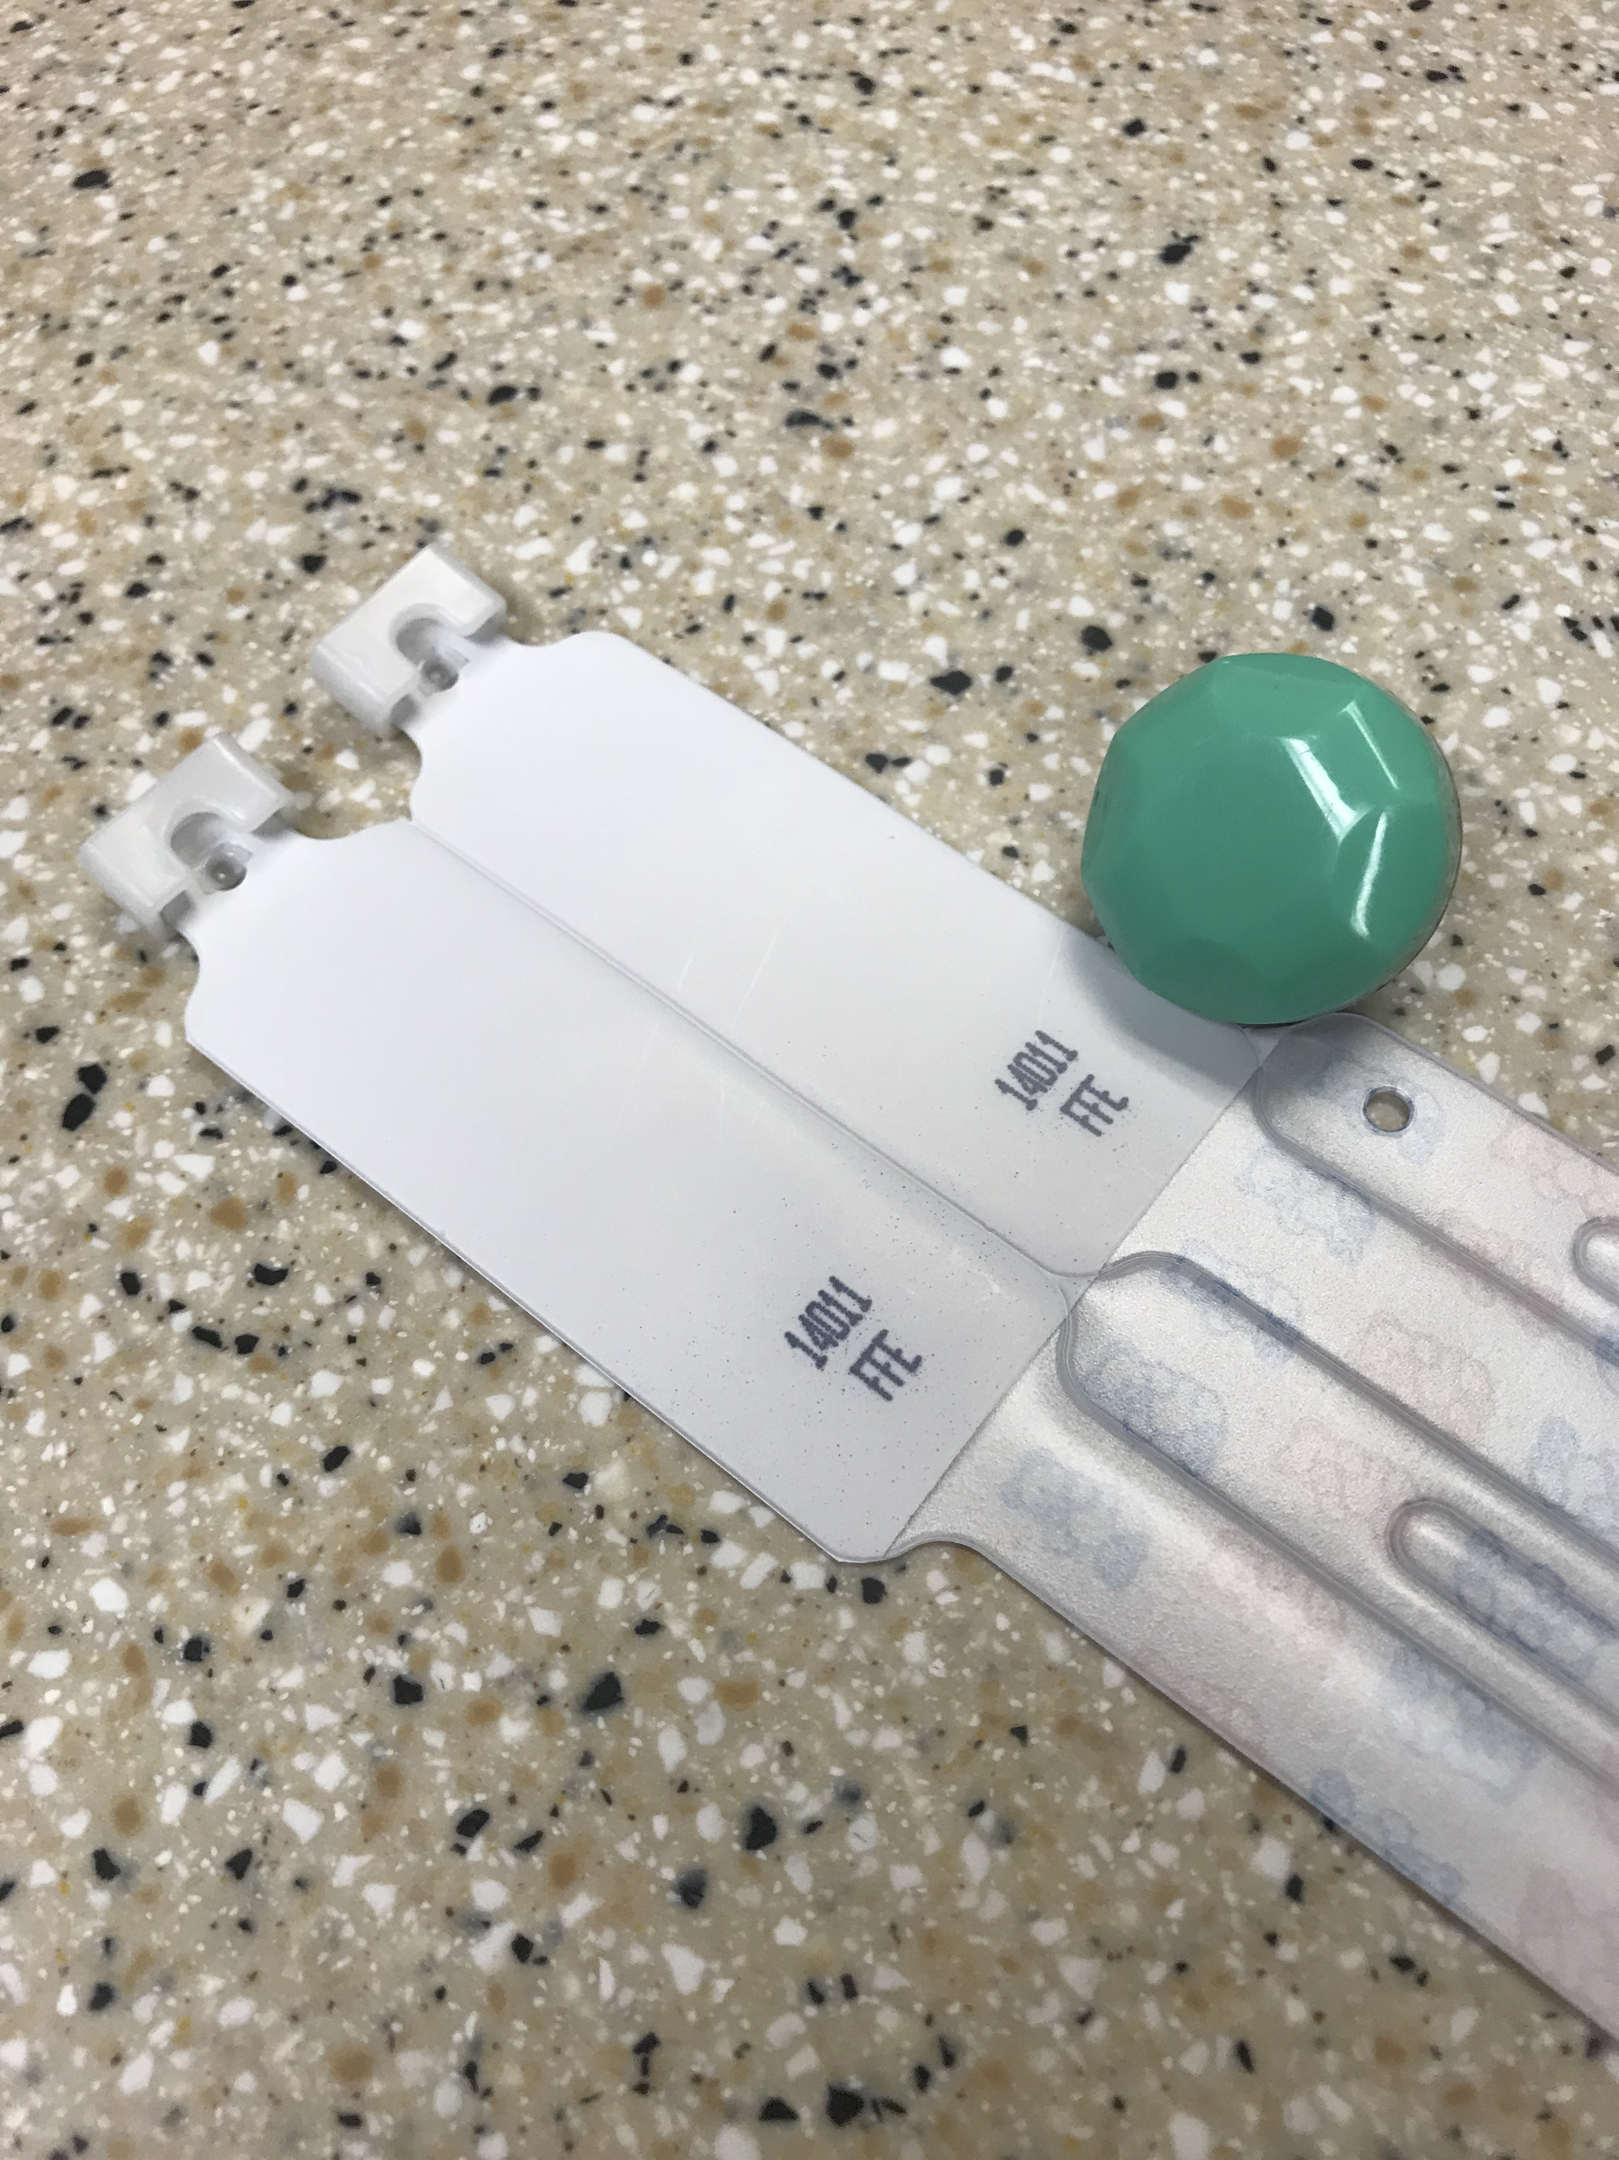
Security and Safety
Not a locked unit
ID bracelets x 2
Totguard
Nursing badge color
Notes:
We are not a locked unit for visitors because we have other forms of security. ***During the concerns with COVID-19, there will not be any visitors allowed on the unit other than your x1 designated support person.***
See picture above… The baby will get x2 bracelets for the feet that will have the unique 5-number identification number, you will get x1 bracelet, and your support person will receive the other bracelet all with the same number. These numbers can be verified at any time. The totguard is the green circle-like device in the picture above. It is painlessly attached to the baby’s umbilical cord clip and removed at discharge. It is an alarm device that notifies us if the baby were to leave our unit under any circumstance. (It also alarms when a baby is to get close to the doors.) They each have numbers that that are assigned to only your baby on your admission.
All the nursing staff on our unit have a pink background badge to further help ensure safety with care of newborns.

Slide 12
Tour of the Unit
Women and Children’s Center
2nd Floor
828-696-4230
Notes:
Sadly, we are not able to offer this at this time due to COVID-19 concerns/risk for exposure.
After reviewing this PowerPoint with notes provided and watching the video links, if you have any questions or concerns, please email me at: sierra.gossett@unchealth.unc.edu
Please keep in mind, I do not check this email daily, but do check it a couple times a week, so please be patient with me. ☺
Congratulations on your pregnancy and thank you for choosing Pardee Hospital for your birthing experience! We cannot wait to see you soon!

